Slide 1
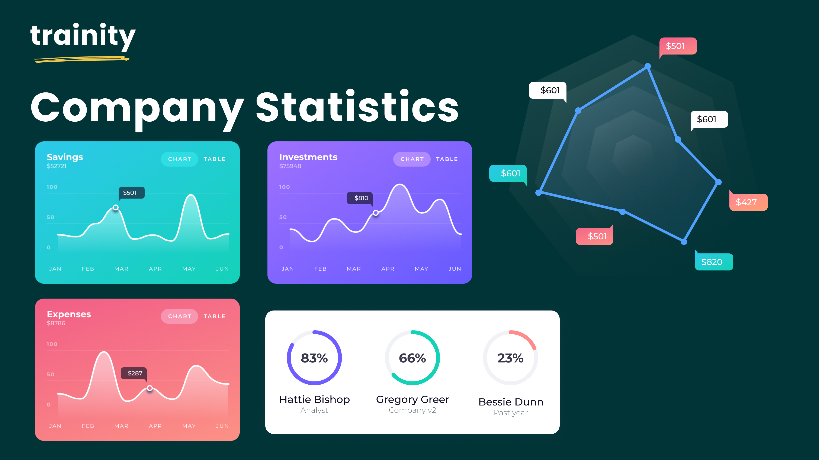
Hiring Process Analytics
By Sudhansu

Slide 2
AGENDA
Project Description
Approach
Tech-Stack Used
Insights
Result

Slide 3

Project Description
Analyzing previous hiring dataset of an MNC to observe trends and drawing insights out of it useful for hiring department.
The dataset of the company has the details about people who registered for a particular post in a department of this company.
Using the knowledge in statistics and different formulas in excel and drawing necessary conclusions about the company.

Slide 4
Approach
Downloaded and imported the dataset in the excel, performed data cleaning i.e. removing missing & invalid rows and handling outliers. Used pivot table and excel chart to draw graphs and finding insights.
And finally drawn conclusions from insights and made a report.
Tech-Stack Used
Used Microsoft Excel version 2305, for data cleaning and visualizations. As Excel offers several powerful tools for data visualization that can help you analyze and understand your data better. With features such as charts, graphs, pivot tables, and other formatting options.

Slide 5
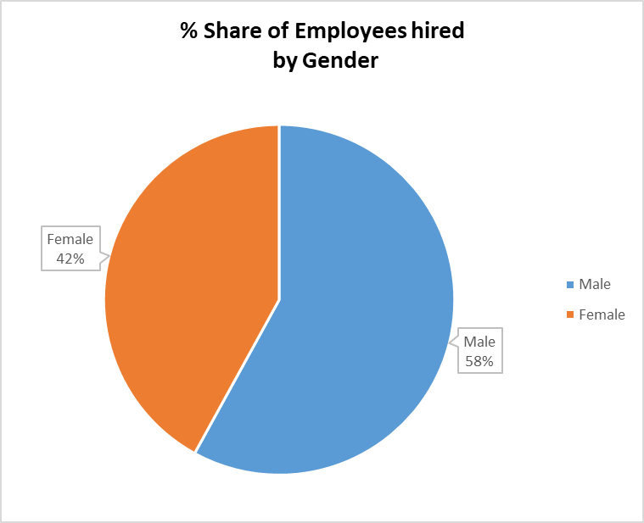
Insights
Hiring: Process of intaking of people into an organization for different kinds of positions. task: How many males and females are Hired ?

Slide 6
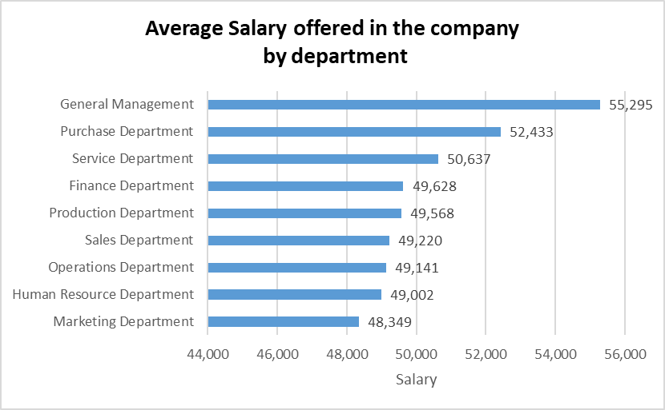
Insights
Average Salary: Adding all the salaries for a select group of employees and then dividing the sum by the number of employees in the group. task: What is the average salary offered in this company ?
General Management and Purchase Department has the highest avg. salary among all the departments in the company.

Slide 7
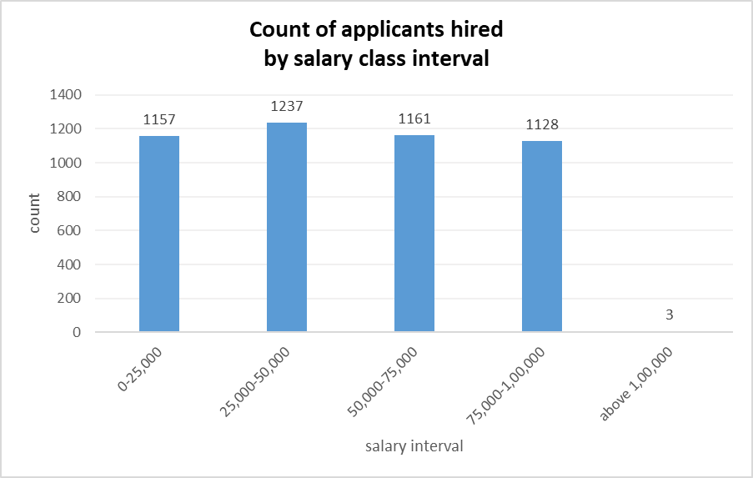
Insights
Class Intervals: The class interval is the difference between the upper class limit and the lower class limit. task: Draw the class intervals for salary in the company ?
All the class interval have approx. uniform hire except only 3 hire above salary 1lac.

Slide 8
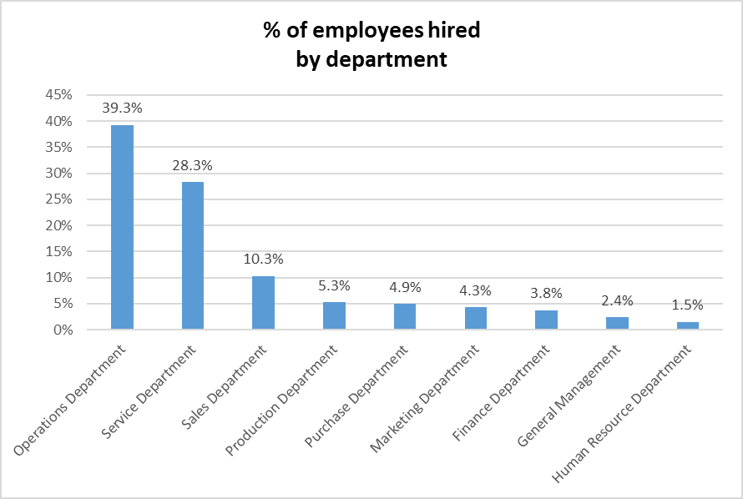
Insights
Charts and Plots: This is one of the most important part of analysis to visualize the data. task: Draw Pie Chart / Bar Graph ( or any other graph ) to show proportion of people working different department ?
Operations Department and Service Department has the highest hiring.
Whereas Human Resource Department and General Management has the lowest hiring.

Slide 9
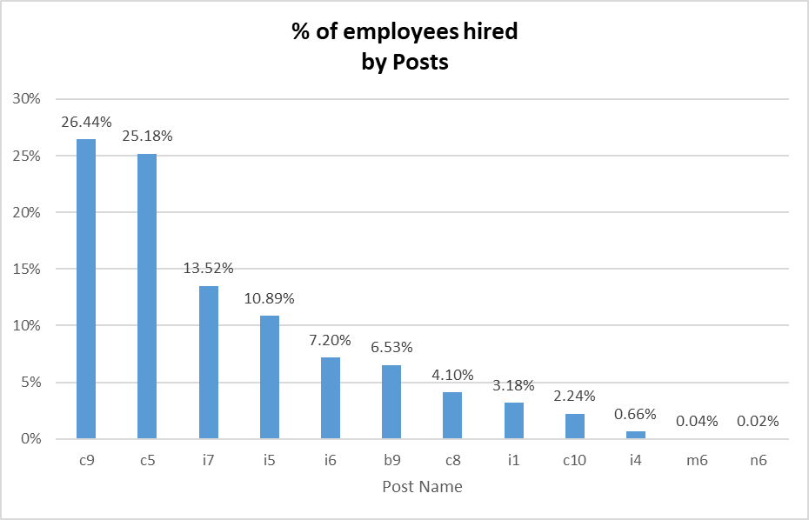
Insights
Charts: Use different charts and graphs to perform the task representing the data. task: Represent different post tiers using chart/graph?
C9 and c5 posts have the highest whereas m6 and n6 posts has the lowest hiring.

Slide 10
Results
Conclusions from above analysis :
Females(42%) are hired less as compared to the Males(58%) in the company.
Average salary offered in the company is 50k.
General management department has given the highest avg. salary(55,000) along with very low hiring in this department.
Only 3 employees have got salary above 1lac.
Highest hiring is done for the c9 post.

Slide 11
Thank you

